Slide 1
Chapter 4b: VLANs (II)
Routing & Switching
Notes:
Cisco Networking Academy program
Routing & Switching
Chapter 3: VLANs

Slide 2
Chapter 3b
3.1 VLAN Segmentation
3.2 VLAN Implementation
Notes:
Chapter 3

Slide 3
Chapter 3b: Objectives
Explain the purpose of VLANs in a switched network.
Analyze how a switch forwards frames based on VLAN configuration in a multi-switched environment.
Configure a switch port to be assigned to a VLAN based on requirements.
Configure a trunk port on a LAN switch.
Troubleshoot VLAN and trunk configurations in a switched network.
Notes:
Chapter 3 Objectives

Slide 4
3.2 VLAN Implementations
Notes:
Cisco Networking Academy program
Routing & Switching
Chapter 3: VLANs

Slide 5
VLAN Assignment
VLAN Ranges on Catalyst Switches
Cisco Catalyst 2960 and 3560 Series switches support over 4,000 VLANs.
VLANs are split into two categories:
  Normal range VLANs
    VLAN numbers from 1 to 1,005
    Configurations stored in the vlan.dat (in the flash memory)
  Extended Range VLANs
    VLAN numbers from 1,006 to 4,096
    Configurations stored in the running configuration (NVRAM)
Notes:
3.2.1.1 VLAN Ranges On Catalyst Switches

Slide 6
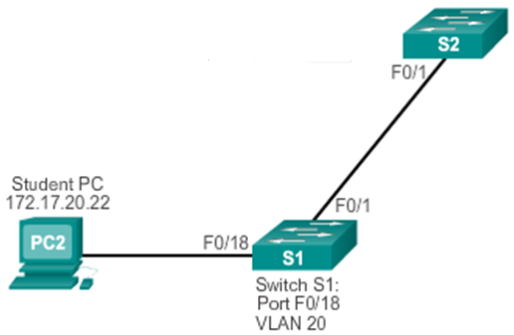
VLAN Assignment
Configuring VLANs in Switches
VLAN configuration for switches consists of these steps:
Create VLANs
Assign switch ports to the respective VLANs
Verify configuration and test
Delete / Modify where necessary
Trunk port
Access port

Slide 7
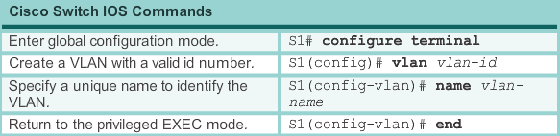
VLAN Assignment
Creating a VLAN
Example:-
S1# conf t
S1(config)# vlan 20
S1(config-vlan)# name Student
S1(config-vlan)# exit
Access port
Notes:
3.2.1.2 Creating a VLAN

Slide 8
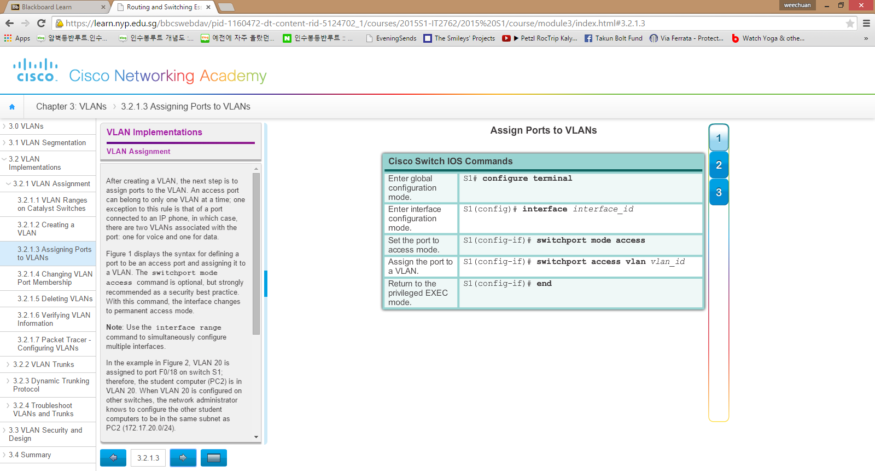
VLAN Assignment
Assigning Ports to VLANs
Example:-
S1# conf t
S1(config)# interface fa0/18
S1(config-if)# swi mod acc
S1(config-if)# swi acc vlan 20
S1(config-if)# exit
Note: To configure several interfaces at once,
Use #interface range fa0/x – fa0/y
OR #interface range fa0/x,fa0/y,fa0/z
Access port
Notes:
3.2.1.3 Assigning Ports To VLANs

Slide 9
VLAN Assignment
Verifying VLAN Information
Verify VLAN configuration using these commands:-
  Switch# show vlan brief
  Switch# show running-config
Before creating VLAN (default):-
S1#show vlan brief
VLAN Name Status Ports
---- -------------------------------- --------- ------------------------------
1 default active Fa0/1, Fa0/2, Fa0/3, Fa0/4
Fa0/5, Fa0/6, Fa0/7, Fa0/8
Fa0/9, Fa0/10, Fa0/11, Fa0/12
Fa0/13, Fa0/14, Fa0/15, Fa0/16
Fa0/17, Fa0/18, Fa0/19, Fa0/20
Fa0/21, Fa0/22, Fa0/23, Fa0/24
Gig0/1, Gig0/2
1002 fddi-default active
1003 token-ring-default active
1004 fddinet-default active
1005 trnet-default active
Notes:
3.2.1.6 Verifying VLAN Information

Slide 10
VLAN Assignment
Verifying VLAN Information
After creating VLAN and before assigning the port:-
S1#show vlan brief
VLAN Name Status Ports
---- -------------------------------- --------- ------------------------------
1 default active Fa0/1, Fa0/2, Fa0/3, Fa0/4
Fa0/5, Fa0/6, Fa0/7, Fa0/8
Fa0/9, Fa0/10, Fa0/11, Fa0/12
Fa0/13, Fa0/14, Fa0/15, Fa0/16
Fa0/17, Fa0/18, Fa0/19, Fa0/20
Fa0/21, Fa0/22, Fa0/23, Fa0/24
Gig0/1, Gig0/2
20 Student active
1002 fddi-default active
1003 token-ring-default active
1004 fddinet-default active
1005 trnet-default active
Notes:
3.2.1.6 Verifying VLAN Information

Slide 11
VLAN Assignment
Verifying VLAN Information
After assigning the port to VLAN 20:-
S1#show vlan brief
VLAN Name Status Ports
---- -------------------------------- --------- ------------------------------
1 default active Fa0/1, Fa0/2, Fa0/3, Fa0/4
Fa0/5, Fa0/6, Fa0/7, Fa0/8
Fa0/9, Fa0/10, Fa0/11, Fa0/12
Fa0/13, Fa0/14, Fa0/15, Fa0/16
Fa0/17, Fa0/19, Fa0/20
Fa0/21, Fa0/22, Fa0/23, Fa0/24
Gig0/1, Gig0/2
20 Student active Fa0/18
1002 fddi-default active
1003 token-ring-default active
1004 fddinet-default active
1005 trnet-default active
Notes:
3.2.1.6 Verifying VLAN Information

Slide 12
VLAN Assignment
Verifying VLAN Information
# show running-config
Note that VLANs created can’t be seen in running-config. You need to use # show vlan brief.
S1#show run
<-- output omitted -->
interface FastEthernet0/18
switchport access vlan 20
switchport mode access
<-- output omitted -->
Notes:
3.2.1.6 Verifying VLAN Information

Slide 13
VLAN Assignment
Changing VLAN Port Membership
If the port has been re-assigned to another VLAN, you need to:-
  Check that the new VLAN has been created
  At the interface, set the new access VLAN (example VLAN 30):-
  S1(config)# int fa0/18
  S1(config-if)# switchport access vlan 30
To reset the port to VLAN 1 (back to default state):-
  S1(config)# int fa0/18
  S1(config-if)# no switchport access vlan
Notes:
3.2.1.4 Changing VLAN Port Membership

Slide 14
VLAN Assignment
Deleting VLANs
If a VLAN is no longer needed, delete it by:-
  S1(config)# no vlan vlan-id
Always check after doing a configuration. What command allows you to see that the vlan has been deleted?
S1(config)# __________________
S1# __________________________
(Challenge)
Ports Fa0/1 to Fa0/10 are assigned to VLAN 10. PCs are connected to these 10 ports and can communicate.
What happens when you delete VLAN 10?
(try simulating it with Packet Tracer)
exit
show vlan brief
Notes:
3.2.1.5 Deleting VLANs

Slide 15
VLAN Assignment
Configuring IEEE 802.1q Trunk Links
Trunk links are links between switches and it allows multiple VLANs to traverse the link using the IEEE 802.1q frame tagging protocol
To configure a trunk link, the trunk ports on both ends need to be configured. Referring to the network diagram, these ports must be configured:-
  Switch S1 port Fa0/1
  Switch S2 port Fa0/1
Trunk port
Notes:
3.2.2.1 Configuring IEEE 802.1q Trunk Links

Slide 16
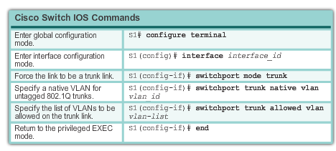
VLAN Assignment
Configuring IEEE 802.1q Trunk Links
Notes:
3.2.2.1 Configuring IEEE 802.1q Trunk Links

Slide 17
VLAN Assignment
Configuring IEEE 802.1q Trunk Links
Identify the assigned Native VLAN (if available)
Identify whether the trunk will permit some or all VLANs
Configure Switch S1 port Fa0/1 to be a trunk port with the native VLAN (if available, in this example, 99):-
S1# conf t
S1(config)# interface fa0/1
S1(config-if)# switchport mode trunk
S1(config-if)# switchport trunk native vlan 99
Configure Switch S2 port Fa0/1 similarly
Trunk port
Notes:
3.2.2.1 Configuring IEEE 802.1q Trunk Links

Slide 18
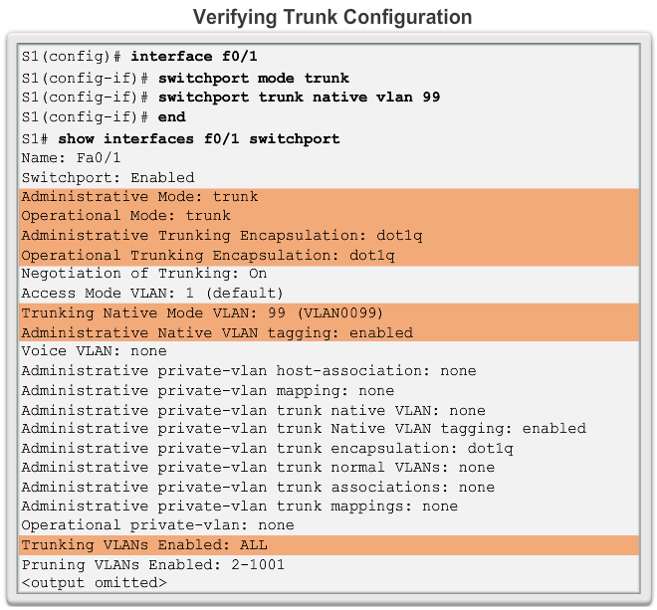
VLAN Assignment
Verifying Trunk Configuration
Notes:
3.2.2.3 Verifying Trunk Configuration

Slide 19
VLAN Assignment
Verifying Trunk Configuration
Always verify trunk configuration:
Switch# show interfaces interface-id switchport
Switch# show running-config
Notes:
3.2.2.3 Verifying Trunk Configuration

Slide 20
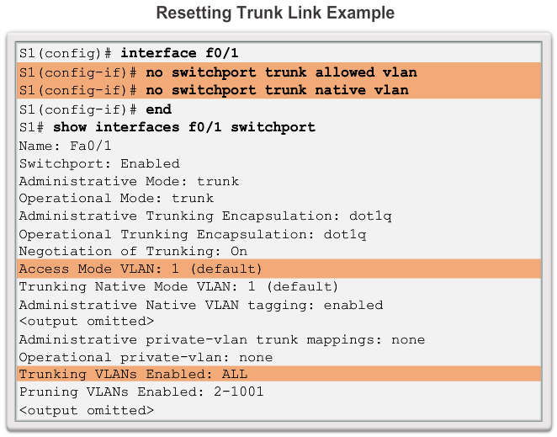
VLAN Assignment
Resetting the Trunk To Default State
To remove a trunk configuration from an interface…
Always verify your configuration.
Notes:
3.2.2.2 Resetting the Trunk To Default State

Slide 21
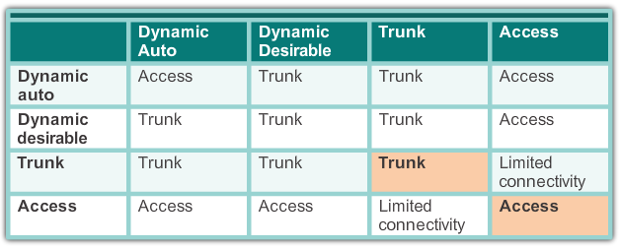
Dynamic Trunking Protocol
Negotiated Interface Modes
Cisco Catalyst 2960 and 3560 support the following trunk modes:
  Switchport mode dynamic auto
  Switchport mode dynamic desirable
  Switchport mode trunk
  Switchport nonegotiate
Notes:
3.2.3.2 Introduction to DTP

Slide 22
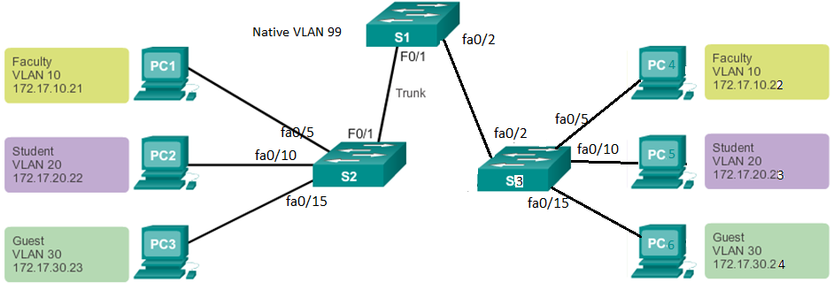
VLAN Assignment
Try it…
Notes:
3.2.4.1 IP Addressing Issues with VLAN

Slide 23
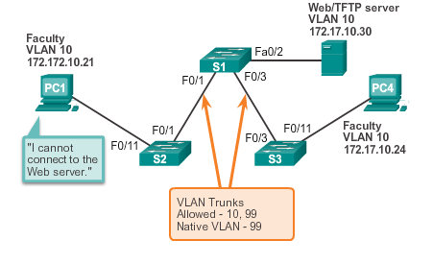
Troubleshooting VLANs and Trunks
IP Addressing Issues with VLAN
A VLAN is an IP network on its own.
All devices within a VLAN can communicate.
The figure shows that PC1 cannot communicate to the server. What is wrong? (hint: see the IP address)
Notes:
3.2.4.1 IP Addressing Issues with VLAN

Slide 24
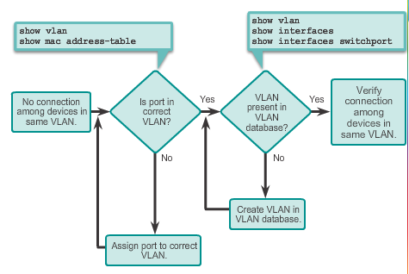
Troubleshooting VLANs and Trunks
Missing VLANs
If all the IP addresses mismatches have been solved, but the device still cannot connect, check if the VLAN exists in the switch.
Notes:
3.2.4.2 Missing VLANs

Slide 25
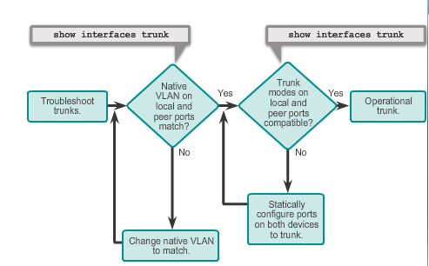
Troubleshooting VLANs and Trunks
Introduction to Troubleshooting Trunks
Notes:
3.2.4.3 Introduction to Troubleshooting Trunks

Slide 26
Troubleshooting VLANs and Trunks
Common Problems with Trunks
Trunking issues are usually associated with incorrect configurations.
The most common type of trunk configuration errors are:
  Native VLAN mismatches
    native VLANs must match across a switch network
  Trunk mode mismatches
    switch port must be configured as trunk at both ends
  Allowed VLANs on trunks
    was additional configuration made to allow only certain VLANs?
Notes:
3.2.4.4 Common Problems With Trunks

Slide 27
Chapter 4b: Summary
This chapter:
Introduced VLANs and their types
Described the connection between VLANs and broadcast domains
Discussed IEEE 802.1Q frame tagging and how it enables differentiation between Ethernet frames associated with distinct VLANs as they traverse common trunk links.
Examined the configuration, verification, and troubleshooting of VLANs and trunks.
Notes:
Chapter 3 Summary

